Slide 1
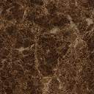
Transportation Problem
Staring Feasible Basic Solution
(North-West Corner Method)
Operations Research
Amjad Ali

Slide 2
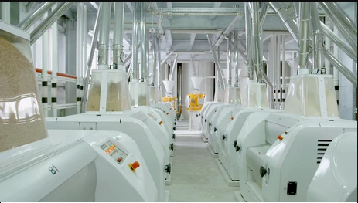
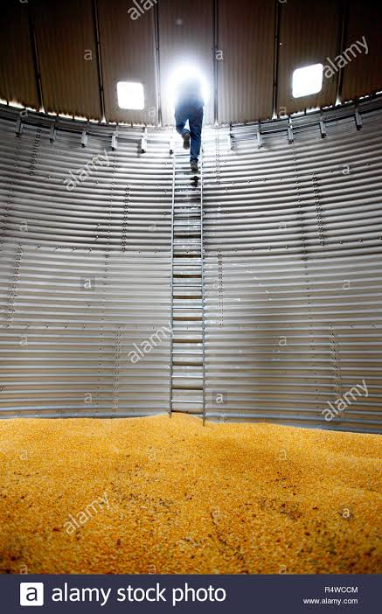
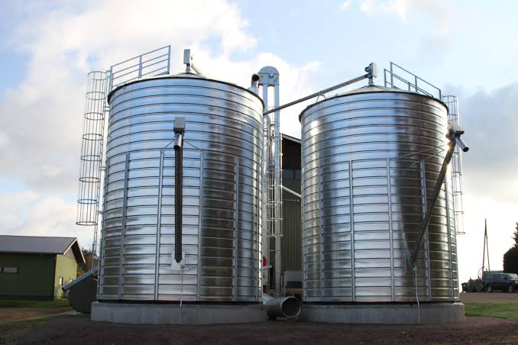
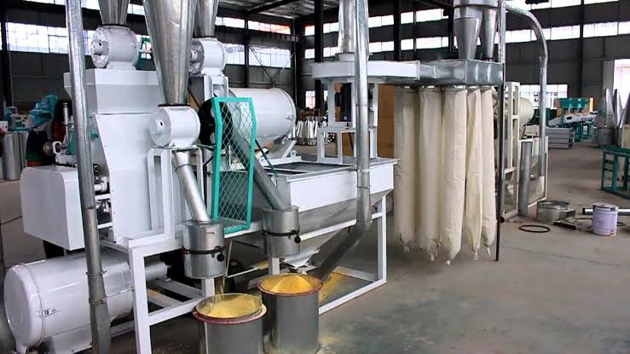
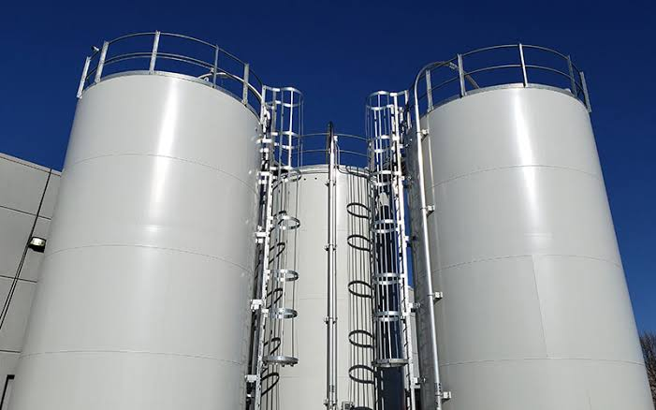
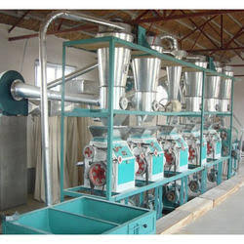
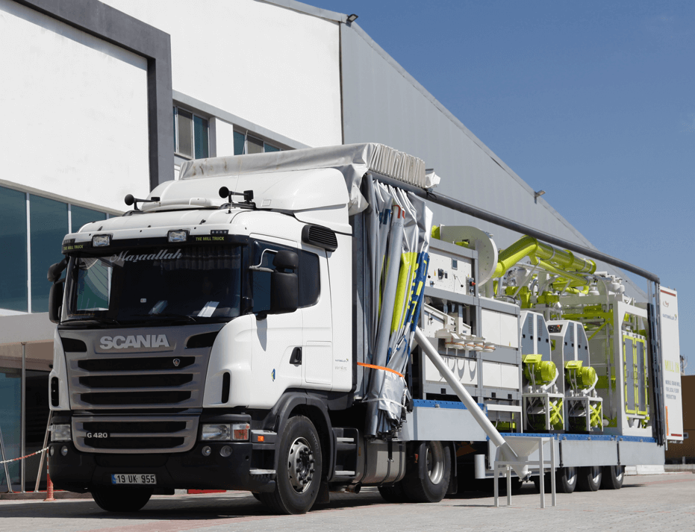
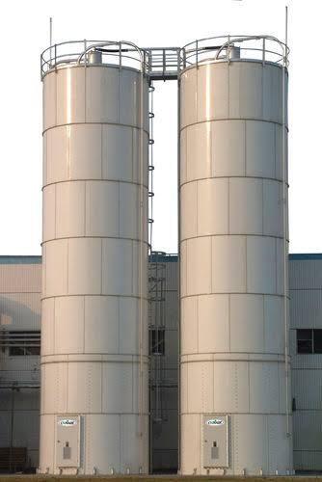
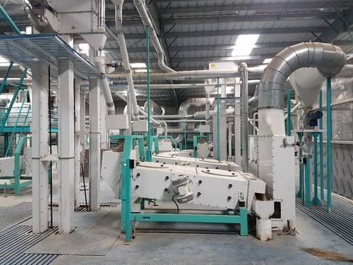
Transportation Problem
Mill 1
Silo 1
Mill 2
Grains
Silo 2
Mill 3
Silo 3
Mill 4

Slide 3
Demand
Transportation Problem
5
Supply
Mill 1
15
15
Silo 1
Mill 2
25
15
Silo 2
Mill 3
10
15
Silo 3
Mill 4

Slide 4
Demand
Transportation Problem
5
Supply
$ 10
Mill 1
15
$ 2
15
$ 20
Silo 1
$ 11
Mill 2
25
15
Silo 2
Mill 3
10
15
Silo 3
Mill 4

Slide 5
Demand
Transportation Problem
5
Supply
Mill 1
15
$ 12
15
Silo 1
$ 7
Mill 2
25
$ 9
15
$ 20
Silo 2
Mill 3
10
15
Silo 3
Mill 4

Slide 6
Demand
Transportation Problem
5
Supply
Mill 1
15
15
Silo 1
$ 4
Mill 2
25
$ 14
15
Silo 2
$ 16
Mill 3
10
$ 18
15
Silo 3
Mill 4

Slide 7
Demand
Transportation Problem
5
Supply
Mill 1
15
15
Silo 1
Mill 2
25
15
Silo 2
Mill 3
10
15
Silo 3
Mill 4

Slide 8
Demand
Transportation Problem
5
Supply
Mill 1
15
15
Silo 1
Mill 2
25
15
Silo 2
Mill 3
10
15
Silo 3
Mill 4

Slide 9
Transportation Problem
MILL
1
2
3
4
Supply
10
2
20
11
1
x₁₁
15
x₁₂
x₁₃
x₁₄
12
7
9
20
SILO
2
x₂₁
x₂₂
x₂₃
x₂₄
25
4
14
16
18
3
x₃₂
x₃₃
x₃₄
10
x₃₁
Demand
5
15
15
15

Slide 10
Transportation Problem
Generalization
Sources
Destinations
a₁
C₁₁ : X₁₁
1
1
b₁
C₁₂ : X₁₂
a₂
2
C_{1n} : X_{1n}
C₁₃ : X₁₃
2
b₂
a₃
3
- - - - - - -
3
b₃
- - - - - - -
- - - - - - -
- - - -
- - - -
- - - -
C_{m1} : X_{m1}
- - - -
- - - -
C_{m2} : X_{m2}
- - - -
C_{m3} : X_{m3}
a_{m}
m
n
b_{n}
C_{mn} : X_{mn}

Slide 11
Transportation Problem
Simplex Method
Staring Solution
: North-West Corner Method
Starts at the northwest-corner cell (route) of the tableau (variable x₁₁).
MILL
1
2
3
4
Supply
10
2
20
11
1
15
12
7
9
20
SILO
2
25
4
14
16
18
3
10
Demand
5
15
15
15

Slide 12
Transportation Problem
Simplex Method
Staring Solution
: North-West Corner Method
Starts at the northwest-corner cell (route) of the tableau (variable x₁₁).
MILL
1
2
3
4
Supply
10
2
20
11
1
15
12
7
9
20
SILO
2
25
4
14
16
18
3
10
Demand
5
15
15
15

Slide 13
Transportation Problem
Simplex Method
Staring Solution
: North-West Corner Method
MILL
1
2
3
4
Supply
10
2
20
11
1
15
5
12
7
9
20
SILO
2
25
4
14
16
18
3
10
Demand
5
15
15
15

Slide 14
Transportation Problem
Simplex Method
Staring Solution
: North-West Corner Method
MILL
1
2
3
4
Supply
10
2
20
11
1
15
10
5
12
7
9
20
SILO
2
25
4
14
16
18
3
10
5
15
15
15
Demand
0

Slide 15
Transportation Problem
Simplex Method
Staring Solution
: North-West Corner Method
Select northwest-corner cell of the uncrossed section.
MILL
1
2
3
4
Supply
10
2
20
11
1
15
10
5
12
7
9
20
SILO
2
25
4
14
16
18
3
10
5
15
15
15
Demand
0

Slide 16
Transportation Problem
Simplex Method
Staring Solution
: North-West Corner Method
Select northwest-corner cell of the uncrossed section.
MILL
1
2
3
4
Supply
10
2
20
11
1
15
10
5
12
7
9
20
SILO
2
25
4
14
16
18
3
10
5
15
15
15
Demand
0

Slide 17
Transportation Problem
Simplex Method
Staring Solution
: North-West Corner Method
MILL
1
2
3
4
Supply
10
2
20
11
1
15
10
5
10
12
7
9
20
SILO
2
25
4
14
16
18
3
10
5
15
15
15
Demand
0

Slide 18
Transportation Problem
Simplex Method
Staring Solution
: North-West Corner Method
MILL
1
2
3
4
Supply
10
2
20
11
1
15
10
0
5
10
12
7
9
20
SILO
2
25
4
14
16
18
3
10
5
15
5
15
15
Demand
0

Slide 19
Transportation Problem
Simplex Method
Staring Solution
: North-West Corner Method
MILL
1
2
3
4
Supply
10
2
20
11
1
15
10
0
5
10
12
7
9
20
SILO
2
25
4
14
16
18
3
10
5
15
5
15
15
Demand
0

Slide 20
Transportation Problem
Simplex Method
Staring Solution
: North-West Corner Method
Select northwest-corner cell of the uncrossed section.
MILL
1
2
3
4
Supply
10
2
20
11
1
15
10
0
5
10
12
7
9
20
SILO
2
25
4
14
16
18
3
10
5
15
5
15
15
Demand
0

Slide 21
Transportation Problem
Simplex Method
Staring Solution
: North-West Corner Method
Select northwest-corner cell of the uncrossed section.
MILL
1
2
3
4
Supply
10
2
20
11
1
15
10
0
5
10
12
7
9
20
SILO
2
25
4
14
16
18
3
10
5
15
5
15
15
Demand
0

Slide 22
Transportation Problem
Simplex Method
Staring Solution
: North-West Corner Method
MILL
1
2
3
4
Supply
10
2
20
11
1
15
10
0
5
10
12
7
9
20
SILO
2
5
25
4
14
16
18
3
10
5
15
5
15
15
Demand
0

Slide 23
Transportation Problem
Simplex Method
Staring Solution
: North-West Corner Method
MILL
1
2
3
4
Supply
10
2
20
11
1
15
10
0
5
10
12
7
9
20
SILO
2
5
25
20
4
14
16
18
3
10
5
15
0
15
15
Demand
0
5

Slide 24
Transportation Problem
Simplex Method
Staring Solution
: North-West Corner Method
Select northwest-corner cell of the uncrossed section.
MILL
1
2
3
4
Supply
10
2
20
11
1
15
10
0
5
10
12
7
9
20
SILO
2
5
25
20
4
14
16
18
3
10
5
15
0
15
15
Demand
0
5

Slide 25
Transportation Problem
Simplex Method
Staring Solution
: North-West Corner Method
Select northwest-corner cell of the uncrossed section.
MILL
1
2
3
4
Supply
10
2
20
11
1
15
10
0
5
10
12
7
9
20
SILO
2
5
25
20
4
14
16
18
3
10
5
15
0
15
15
Demand
0
5

Slide 26
Transportation Problem
Simplex Method
Staring Solution
: North-West Corner Method
MILL
1
2
3
4
Supply
10
2
20
11
1
15
10
0
5
10
12
7
9
20
SILO
2
5
15
25
20
4
14
16
18
3
10
5
15
0
15
15
Demand
0
5

Slide 27
Transportation Problem
Simplex Method
Staring Solution
: North-West Corner Method
MILL
1
2
3
4
Supply
10
2
20
11
1
15
10
0
5
10
12
7
9
20
SILO
2
5
15
25
20
5
4
14
16
18
3
10
5
15
0
15
0
15
Demand
0
5

Slide 28
Transportation Problem
Simplex Method
Staring Solution
: North-West Corner Method
Select northwest-corner cell of the uncrossed section.
MILL
1
2
3
4
Supply
10
2
20
11
1
15
10
0
5
10
12
7
9
20
SILO
2
5
15
25
20
5
4
14
16
18
3
10
5
15
0
15
0
15
Demand
0
5

Slide 29
Transportation Problem
Simplex Method
Staring Solution
: North-West Corner Method
Select northwest-corner cell of the uncrossed section.
MILL
1
2
3
4
Supply
10
2
20
11
1
15
10
0
5
10
12
7
9
20
SILO
2
5
15
25
20
5
4
14
16
18
3
10
5
15
0
15
0
15
Demand
0
5

Slide 30
Transportation Problem
Simplex Method
Staring Solution
: North-West Corner Method
MILL
1
2
3
4
Supply
10
2
20
11
1
15
10
0
5
10
12
7
9
20
SILO
2
5
15
5
25
20
5
4
14
16
18
3
10
5
15
0
15
0
15
Demand
0
5

Slide 31
Transportation Problem
Simplex Method
Staring Solution
: North-West Corner Method
MILL
1
2
3
4
Supply
10
2
20
11
1
15
10
0
5
10
12
7
9
20
SILO
2
5
15
5
25
20
5
0
4
14
16
18
3
10
5
15
0
15
0
15
10
Demand
0
5

Slide 32
Transportation Problem
Simplex Method
Staring Solution
: North-West Corner Method
MILL
1
2
3
4
Supply
10
2
20
11
1
15
10
0
5
10
12
7
9
20
SILO
2
5
15
5
25
20
5
0
4
14
16
18
3
10
5
15
0
15
0
15
10
Demand
0
5

Slide 33
Transportation Problem
Simplex Method
Staring Solution
: North-West Corner Method
Select northwest-corner cell of the uncrossed section.
MILL
1
2
3
4
Supply
10
2
20
11
1
15
10
0
5
10
12
7
9
20
SILO
2
5
15
5
25
20
5
0
4
14
16
18
3
10
5
15
0
15
0
15
10
Demand
0
5

Slide 34
Transportation Problem
Simplex Method
Staring Solution
: North-West Corner Method
Select northwest-corner cell of the uncrossed section.
MILL
1
2
3
4
Supply
10
2
20
11
1
15
10
0
5
10
12
7
9
20
SILO
2
5
15
5
25
20
5
0
4
14
16
18
3
10
5
15
0
15
0
15
10
Demand
0
5

Slide 35
Transportation Problem
Simplex Method
Staring Solution
: North-West Corner Method
MILL
1
2
3
4
Supply
10
2
20
11
1
15
10
0
5
10
12
7
9
20
SILO
2
5
15
5
25
20
5
0
4
14
16
18
3
10
10
5
15
0
15
0
15
10
Demand
0
5

Slide 36
Transportation Problem
Simplex Method
Staring Solution
: North-West Corner Method
MILL
1
2
3
4
Supply
10
2
20
11
1
15
10
0
5
10
12
7
9
20
SILO
2
5
15
5
25
20
5
0
4
14
16
18
3
10
0
10
5
15
0
15
0
15
10
0
Demand
0
5

Slide 37
Transportation Problem
Simplex Method
Staring Solution
: North-West Corner Method
MILL
1
2
3
4
Supply
10
2
20
11
1
15
10
0
5
10
12
7
9
20
SILO
2
5
15
5
25
20
5
0
4
14
16
18
3
10
0
10
5
15
0
15
0
15
10
0
Demand
0
5

Slide 38
Transportation Problem
Simplex Method
Staring Solution
: North-West Corner Method
1
2
3
4
10
2
20
11
MILL
1
x₁₁
x₁₃
1
2
x₁₂
x₁₄
3
4
Supply
10
20
12
7
9
20
2
11
2
1
15
x₂₁
x₂₂
x₂₃
x₂₄
5
10
4
14
16
18
12
7
9
20
2
25
3
x₃₂
x₃₃
x₃₄
SILO
5
15
5
x₃₁
4
14
16
18
Starting Basic Feasible Solution
3
10
x₁₁ = 5
x₁₂ = 10
10
x₂₂ = 5
x₂₃ = 15
x₂₄ = 5
Demand
5
15
15
15
x₃₄ = 10

Slide 39
Transportation Problem
Simplex Method
Staring Solution
Starting Objective Value (Z Value)
Z = c₁₁ x₁₁ + c₁₂ x₁₂ + c₂₂ x₂₂ + c₂₃ x₂₃ + c₂₄ x₂₄ + c₃₄ x₃₄
MILL
1
2
3
4
Supply
10
2
20
11
1
15
Z =10*5+2*10+7*5+9*15+20*5+18*10
5
10
= 50 + 20 + 35 +135 + 100 + 180
= $ 520
12
7
9
20
SILO
2
5
15
5
25
4
14
16
18
3
10
10
Demand
5
15
15
15

Slide 40
Demand
Transportation Problem
5
Supply
Mill 1
15
15
Silo 1
Mill 2
25
15
Silo 2
Mill 3
10
15
Silo 3
Mill 4

Slide 41
Demand
Transportation Problem
5
Supply
C₁₁ : X₁₁
Mill 1
15
C₁₂ : X₁₂
15
Silo 1
C₂₂ : X₂₂
Mill 2
25
C₂₃ : X₂₃
15
Silo 2
Mill 3
C₂₄ : X₂₄
10
C₃₄ : X₃₄
15
Silo 3
Mill 4

Slide 42
Demand
Transportation Problem
5
Supply
10 : 5
Mill 1
15
2 : 10
15
Silo 1
7 : 5
Mill 2
25
9 : 15
15
Silo 2
Mill 3
20 : 5
10
18 : 10
15
Silo 3
Mill 4

